Slide 1

DDD incontra i Dati
(AKA Data Mesh)

Slide 2
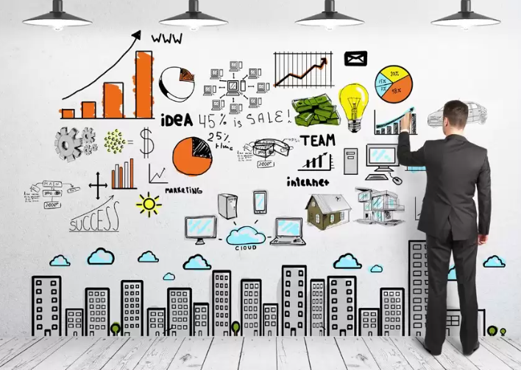
All we need is Data!
All we need is Data!

Slide 3

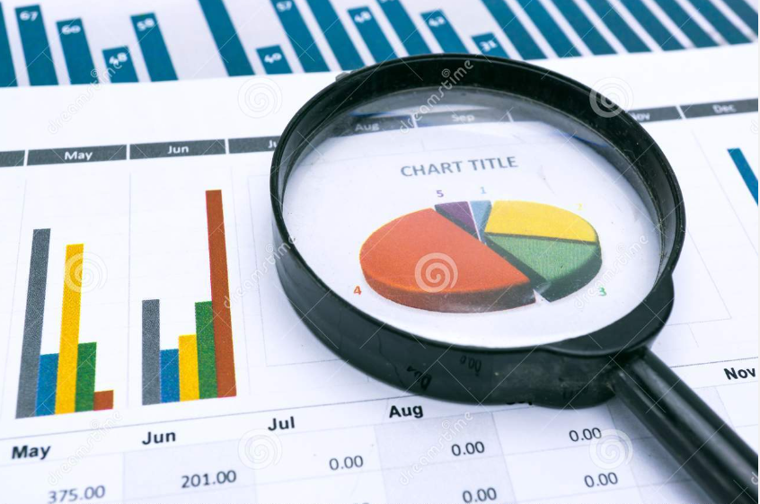
Operational vs Analytical
Operational
Analytical
E
T
L

Slide 4
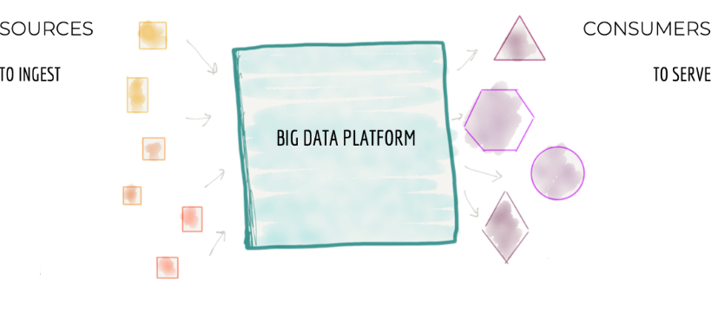
Failure Symptoms
Centralized
Monolithic

Slide 5
Failure Symptoms
Decomposition
INGEST
FEATURES
AGGREGATE
CAPABILITIES
SERVE
Scale Architecture with top-level technical partitioning
Architecture decomposition orthogonal to change

Slide 6
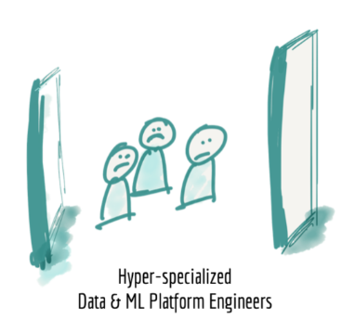
Misintegration
Hyper-specialized silos

Slide 7
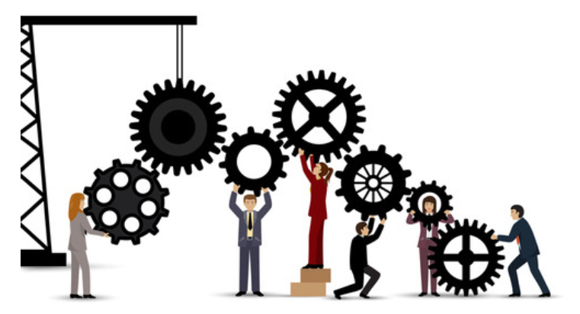
Failure Symptoms
Disconnected

Slide 8
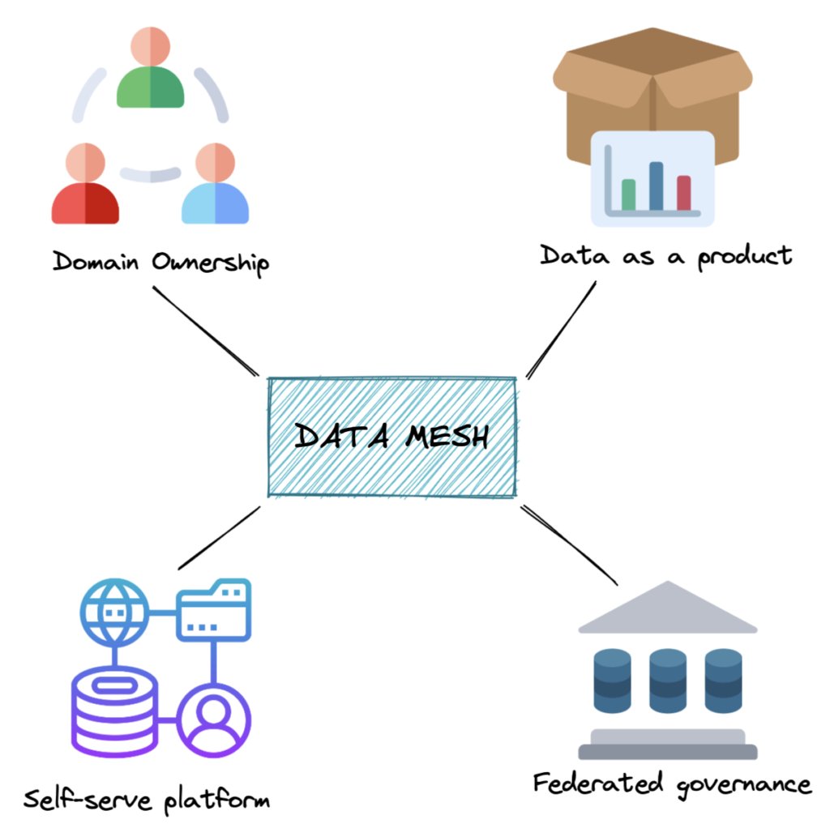
Data Mesh (Zhamak Dehghani)
Data Mesh
(Zhamak Dehghani)

Slide 9
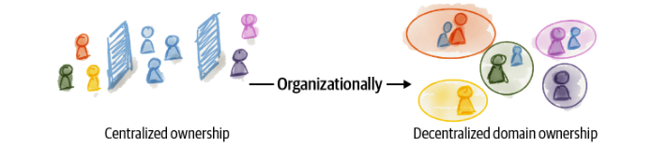
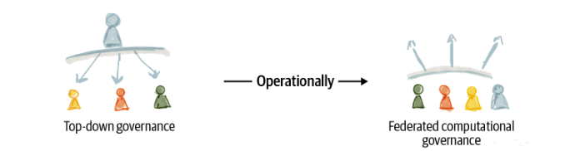
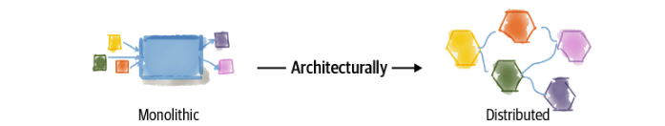
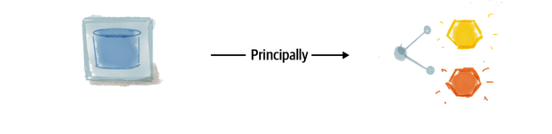
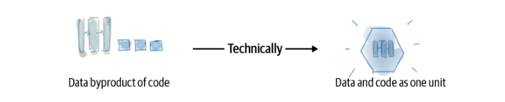
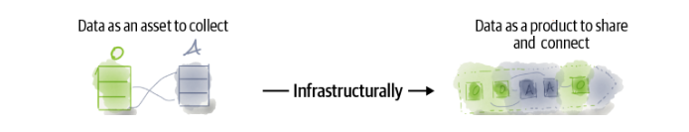
A socio-technical approach

Slide 10
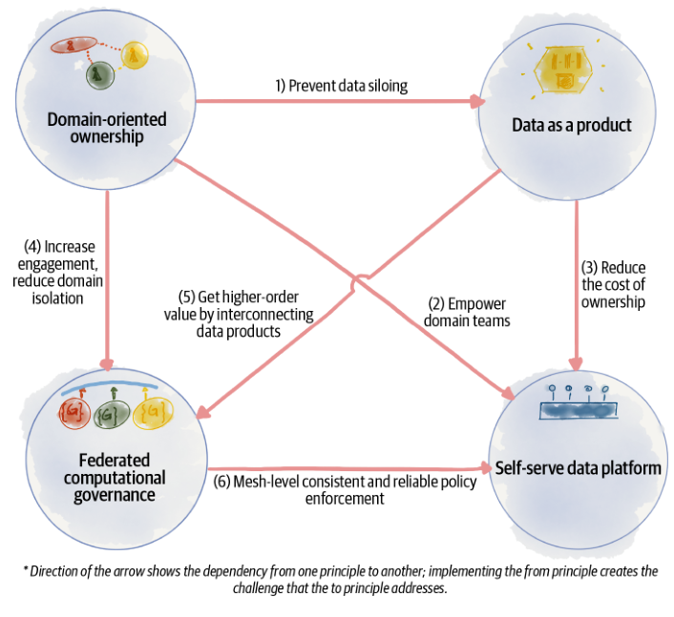
The Principles
The
Principles

Slide 11
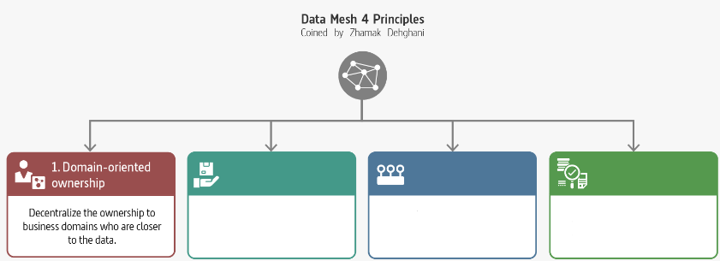
Domain-Oriented Ownership

Slide 12
Decompose Data Around Domains
Domains aligned with the origin of data
Domains aligned with the consumption
Domains aligned with shared aggregates
Distributed the ownership

Slide 13
Motivations
The ability to scale data sharing aligned with the axes of organisation growth
Optimize continuous change by localize change in business domains
Support agility by reducing the need for synchronize between teams
Increase the resilience of ML solutions by removing complex intermediate data collection pipelines

Slide 14
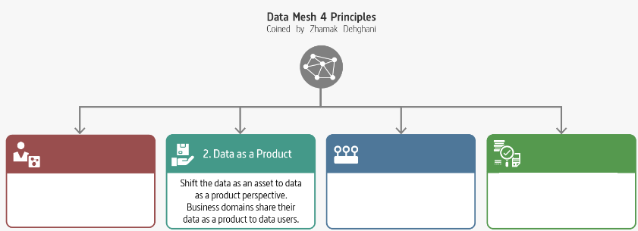
Data as a Product

Slide 15
A Succesful Product
A Succesful Product
Usable
Discoverability
Trusthful (trustworthy)
Interoperable
Valuable
Understanding
Natively Accessible
Feasible
Marty Cagan «Inspired»
Don Norman «The design of every day things»
«A confident relationship with the unknown» Rachel Botsman

Slide 16

Failure Symptoms
Data
Product
Owner

Slide 17

Data
as a
Product
Code
Data Product
Polyglot Data
Infrastructure

Slide 18
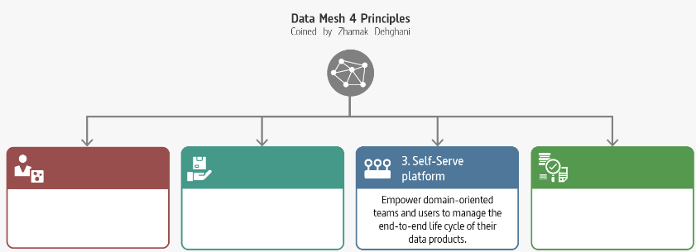
Self-serve Data Platform

Slide 19
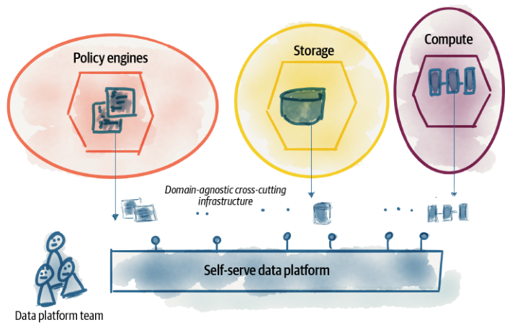
Failure Symptoms
Team
Autonomy

Slide 20
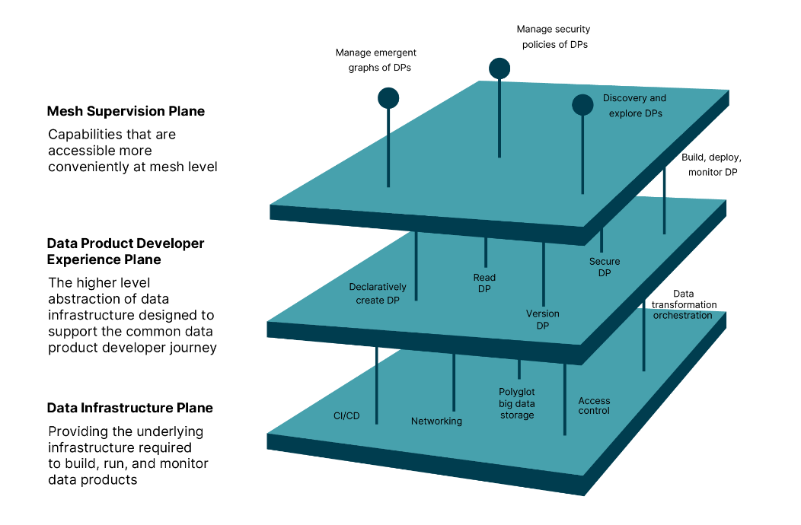
Logical Architecture
Logical
Architecture

Slide 21
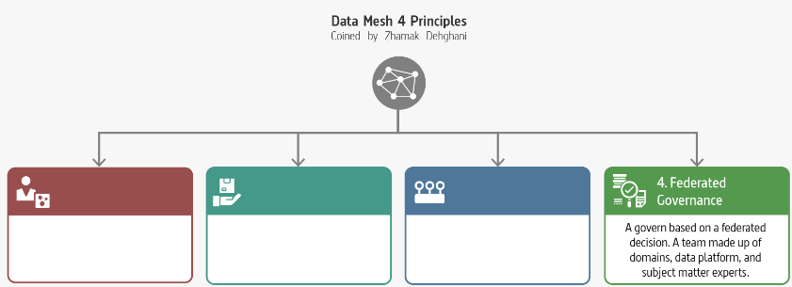
Misintegration
Federated Computional Governances

Slide 22
Federated Computional Governances
Decentralization and domain self-sovereignty
Interoperability through global standardization across data products
A dynamic topology
Automatic exection of decisions and policies by the platform
Maintains equilibrium between centralization and decentralization

Slide 23
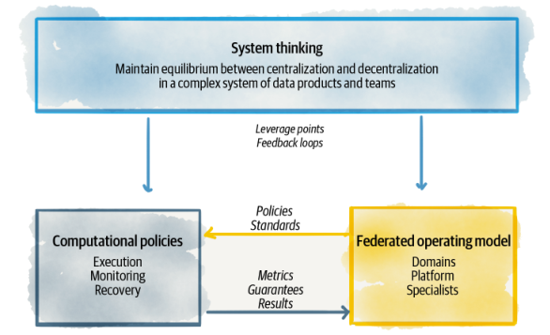
Failure Symptoms
Equilibrium

Slide 24



Slide 25
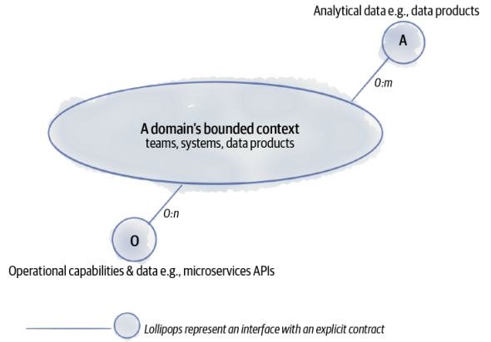
Misintegration
Building a Data Product

Slide 26
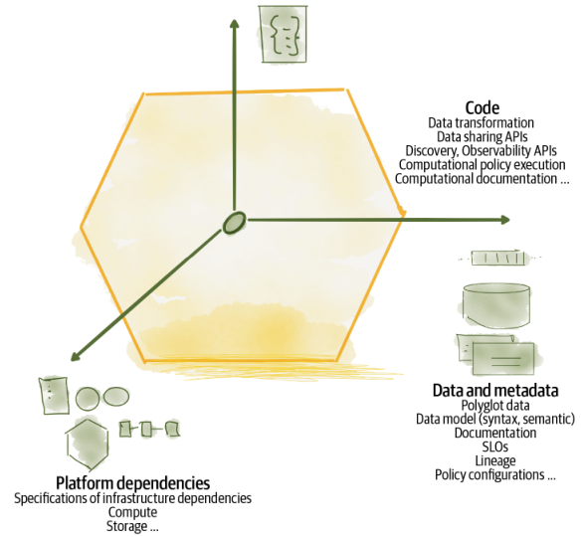
Misintegration
Architectural Quantum

Slide 27
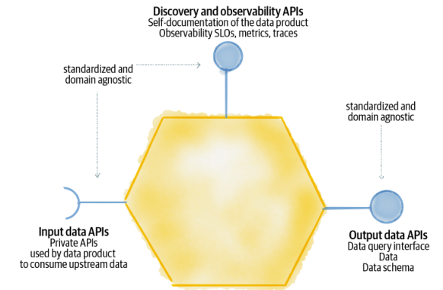
Misintegration
Components

Slide 28
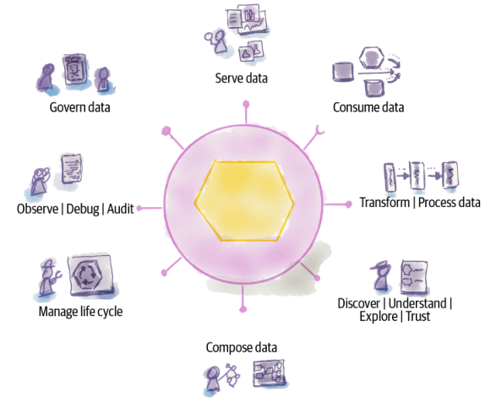
Misintegration
Affordances

Slide 29
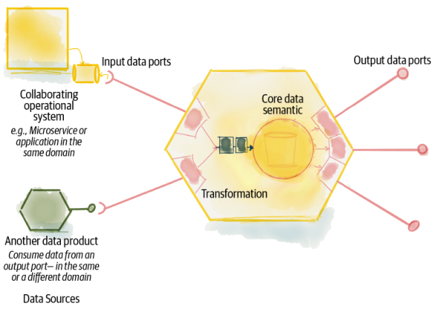

Consume Data

Slide 30
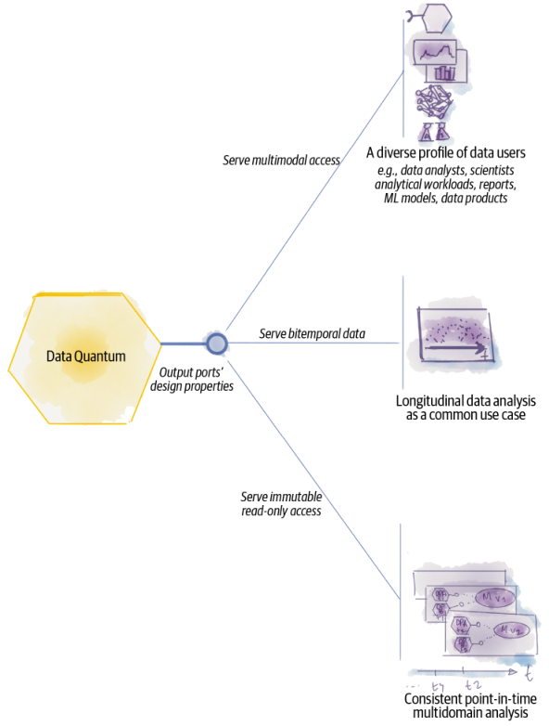
Different Needs

Slide 31
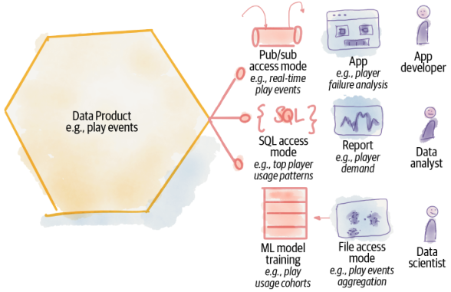
Multimodal Access

Slide 32
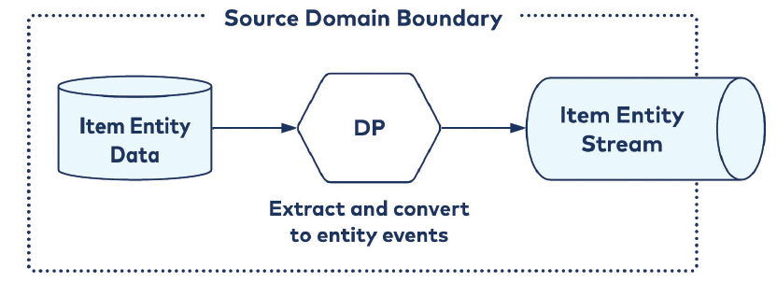
Failure Symptoms
Source Aligned

Slide 33
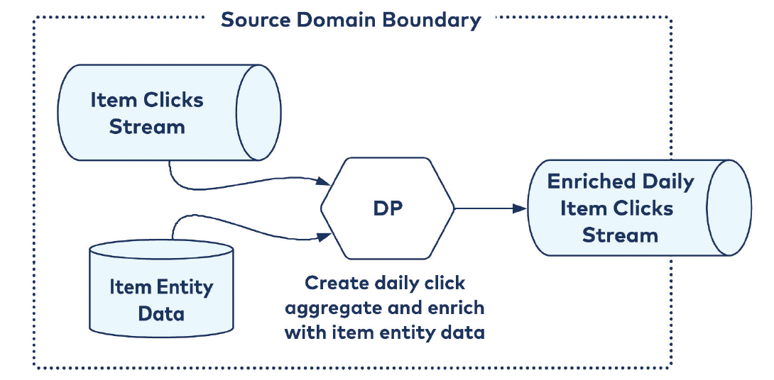
Failure Symptoms
Aggregate Aligned

Slide 34
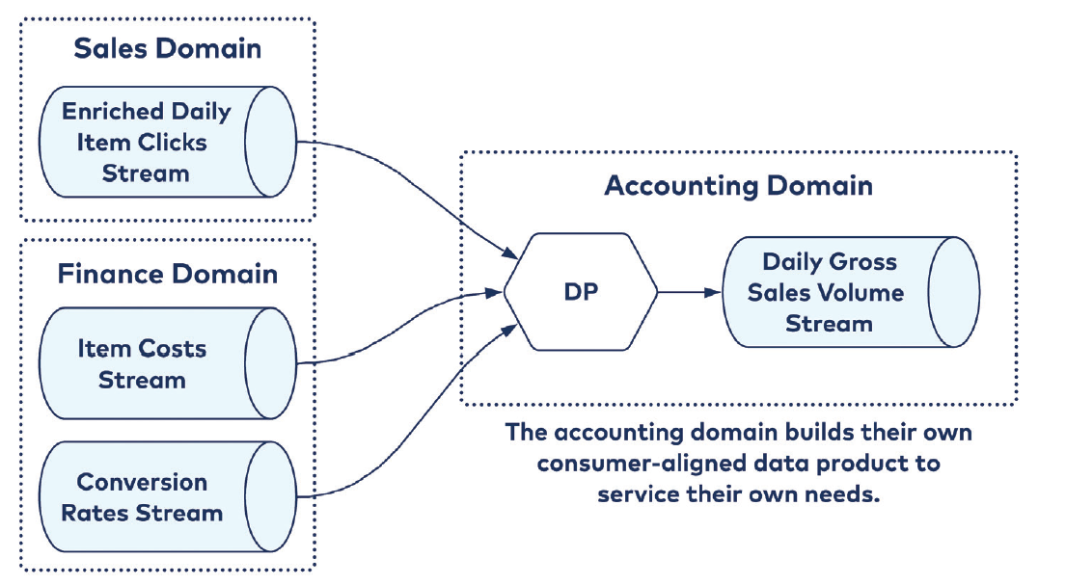
Failure Symptoms
Customer
Aligned

Slide 35

Misintegration
A New Order
You hear that Mr. Anderson? That is the sound of inevitability …

Slide 36
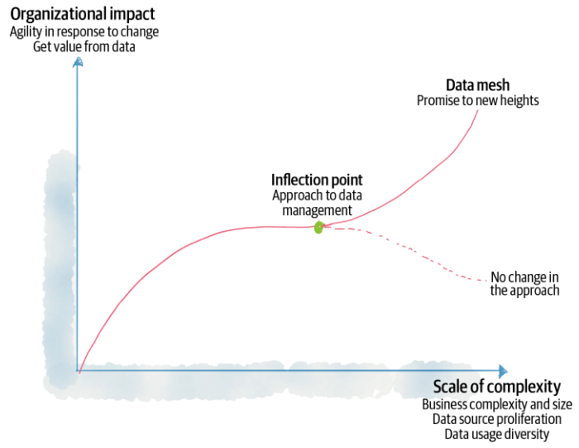
Failure Symptoms
Data Mesh
Inflection Point

Slide 37






Misintegration
References
Zhamak Dehghani
Introduction to Data Mesh
Martin Fowler
Data Mesh Principles and Logical Architecture
Practical Data Mesh

Slide 38





About me
…pronti a Settembre
alberto.acerbis@intre.it
https://github.com/brewup
https://github.com/cqrs-muflone
https://github.com/ace68
https://www.twitch.tv/dddbrewup

